Slide 1


SMART INDIA HACKATHON 2024
Problem Statement ID –1555
Problem Statement Title-Create a Virtual Herbal Garden that provides an interactive, educational, and immersive experience to users, showcasing the diverse range of medicinal plants used in AYUSH (Ayurveda, Yoga & Naturopathy, Unani, Siddha, and Homeopathy).
Theme-MedTech / BioTech / HealthTech
PS Category- Software
Team ID-14
Team Name (Registered on portal)- Team Vrindavan

Slide 2

VIRTUAL HERBAL GARDEN
SOLUTION
We are creating an immersive virtual garden which will be accessible on web as well as on the mobile devices in the form of a web page developed in REACT and NODE.js that show cases medicinal plants used in AYUSH systems. The platform will be interactive and educational, featuring detailed plant profiles, educational content, interactive elements, and community engagement tools.
Key Features:
1. Interactive Garden
2. Plant Information Panels
3. Search Options
4. Plant Product Shopping
5. ChatBot
6. Chat with AYUSH specialist
7. Admin previleges

Slide 3
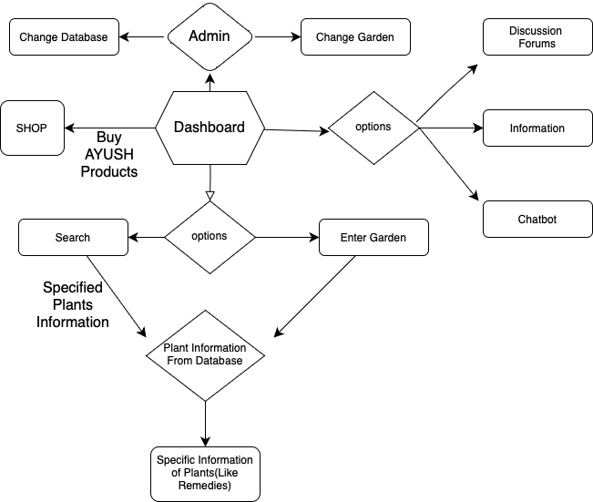
TECHNICAL APPROACH
Programming Languages and Concepts:
ReactJS
Node.JS
Firebase Firestore
Firebase Storage
Methodology
(Flow-Chart) :

Slide 4
FEASIBILITY AND VIABILITY
Feasibility
Design Feasibility
User Experience: Engaging and interactive experience through an intuitive user interface
Market Feasibility
Target Audience: Students, health and wellness enthusiasts, and educators.
Monetization: Potential revenue stream can include paid advertisements.
Viability
Market Viability
Demand: There is a rising interest in natural and alternative medicine.
Financial Viability
Cost Management: Low cost and low risk
Technical Viability
Performance : Private database to ensure reliability and accuracy.
Scalability : Virtual garden can be scaled by expanding the database, adding new features and content based on user feedback.

Slide 5
IMPACT AND BENEFITS
Educational Impact:
Impact: The platform will increase awareness and understanding of AYUSH medicinal plants among a wider audience.
Benefit: It acts as a valuable educational platform.
Cultural Preservation:
Impact : Promoting India’s rich cultural heritage in AYUSH.
Benefit: This effort supports the long-term sustainability of these traditional practices.
Health Awareness:
Impact: The platform provides users with a deeper understanding of the health benefits of AYUSH plants.
Benefit: This promotes healthier lifestyles contributing to overall well-being.

Slide 6
RESEARCH AND REFERENCES
Detailed reference and research work
Research on Medicinal Plants in AYUSH Systems
Ayurveda
Yoga & Naturopathy
Unani
Siddha
Homeopathy
References
Books and Publications: Classical texts for Ayurveda, journals on medicinal plant research.
Also React Up & Running, Learning Node: Moving to the Server-Side for react and Node.js studies.
Research Papers: PubMed and Google Scholar are used for sourcing peer-reviewed research.
Websites for Medicinal Plant Research:
AYUSH Ministry Official Website
National Centre for Complementary and Integrative Health (NCCIH)
Websites for software developmental ideas:
Github.com
W3schools.com

